Slide 1

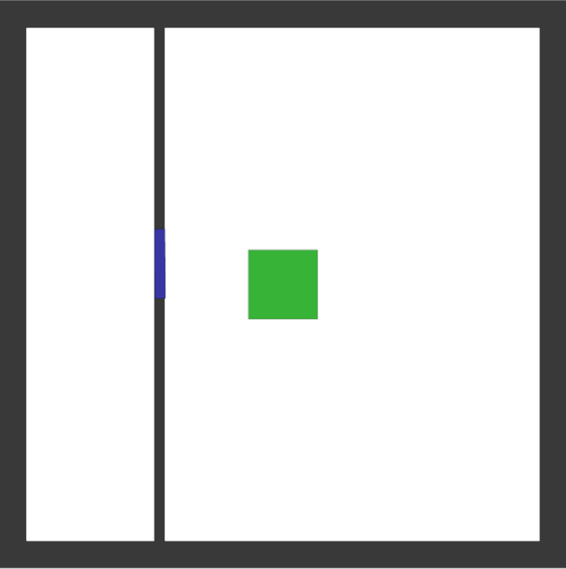
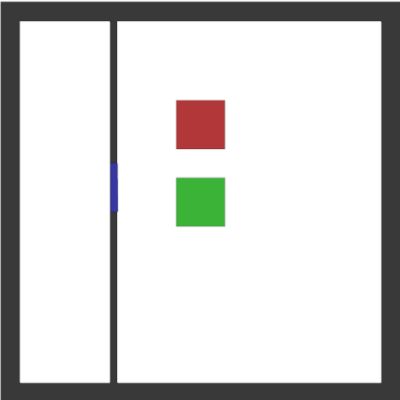


Input LiDAR
Segmentation map LiDAR
Combined segmentation map
Input prior map
Segmentation prior MAP

